Slide 1
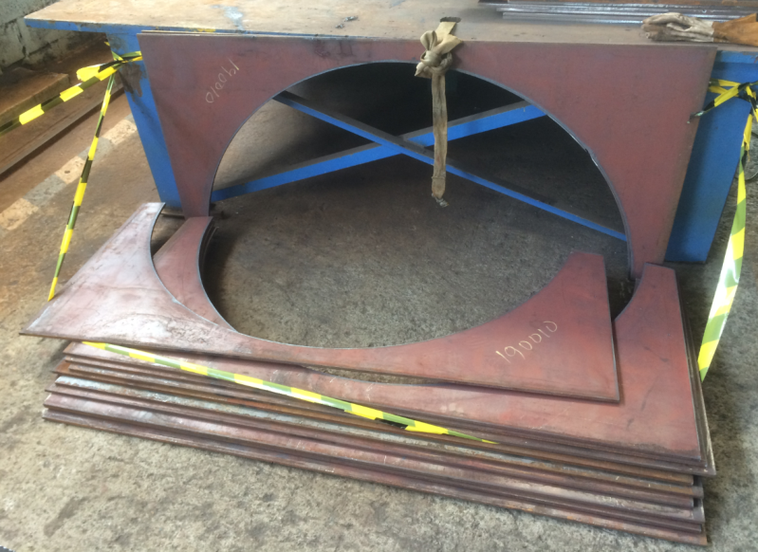

HS&E INCIDENT BULLETIN |  | 1st half year 2017
Cilegon, Indonesia | Type of incident (Ankle Fracture – Struck By)
Summary:
A contractor working in the fabrication area was preparing for a canister leg plate fit up. In the morning he joined the toolbox meeting and was briefed on the job steps that he must do for the shift. At his working area, 12 sheet canister leg plates were stored in standing (vertical) position and tied with a rope. The plates were stored temporarily in a standing position as part of routine housekeeping. Around 8.30 am the contractor wanted to take one of the canister leg plates that he needed to work on. When he untied the rope, 10 sheet plates suddenly fell toward his leg and his leg was trapped between the plate and concrete floor. Two of his colleagues evacuated him and brought him to the hospital for medical treatment. A x-ray at the hospital confirmed he sustained a fracture to his right ankle , which required minor surgery.
Root Causes: | Actions Taken Thus Far: Next Steps
Incorrect storage of metal plates (in vertical position). Negligence, lack of situational awareness and failure to recognize hazard (body part in line of fire). | Stop work was issued and the work piece was cordoned off for investigation. Held safety stand down with all Cilegon SC employees to communicate and discuss this incident. Review existing risk assessment (HIRA) for fit up job and ensure all potential hazards are identified with control measures. Review metal plate storage. Train (refresh) all employees on hazard identification awareness.

